Slide 1

Lab 2 Part-I: Socket Programming Introduction
Instructor
Farwa Ahmad

Slide 2
Why Socket Programming ?
“ To build any Networked Application”
www (internet Explorer, Firefox etc.)
FTP and P2P (Bitcomet)
What is a Socket?
A socket is an abstract representation of a communication endpoint.
A way to speak to other programs using standard Unix file descriptors.
File descriptor: is an integer associated with an open file
File can be a Network connection, pipe or terminal. Everything in Unix is file
Communication with other programs over internet is through File descriptor i.e Socket

Slide 3

Communication in a Network
Client-Server Model
In the socket programming world almost, all communication is based on the Client-Server model.
Server
Is a Passive Entity , Waits for clients Requests
Client
Is a Active Entity, Forwards its request to Server and waits for response

Slide 4
Server and Client
Server and Client exchange messages over the network through a common Socket API
Server
Clients
user
space
ports
TCP/UDP
TCP/UDP
Socket API
kernel
space
IP
IP
Ethernet Adapter
Ethernet Adapter
hardware

Slide 5


Socket API
Interface That OS provides to its networking Subsystem is called Application Programming Interface
Socket Interface is Supported in all popular Operating Systems

Slide 6
Before we dive deeper… Concept of IP Addresses
An Internet Protocol address (IP address) is a numerical label assigned to each device (e.g., computer, printer) participating in a computer network that uses the Internet Protocol for communication
IPv4
32-bit Address made up of four bytes.
Consist of host part and network part.
192.0.111.123
Three Classes A, B , C
IPv6
79 MILLION BILLION TRILLION Addresses
128-bit address space
2001:0db8:c9d2:0012:0000:0000:0000:0051
IPv4 compatibility
::ffff:192.0.2.33

Slide 7
Byte Ordering
Byte ordering or Endianness is the attribute of a system which indicates whether integers are stored / represented left to right or right to left.
Example 1: short int x = 0xAABB (hex). This can be stored in memory as 2 adjacent bytes as either (0xaa , 0xbb) or as (0xbb, 0xaa). Big Endian: Byte Value : [0xAA] [0xBB] Memory : [ 0 ] [ 1 ] Little Endian: Byte Value : [0xBB] [0xAA] Memory : [ 0 ] [ 1 ]

Slide 8
Concept of Byte Order
Big Endian
Most Significant byte first
Network byte order (NBO)
Little Endian
Least Significant byte first
Host byte order (HBO)
All Network data is sent in Big Endian format.
In the networking world we call this representation as Network Byte Order and native representation on the host as Host Byte Order.
We convert all data into Network Byte Order before transmission.
c[0] c[1] c[2] c[3]
128
2
194
95
95
194
2
128

Slide 9
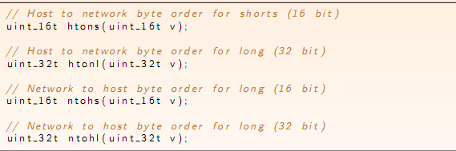
Some utility functions
IP Address format: Ascii dotted to Binary: inet_aton() Binary to Ascii dotted: inet_ntoa()

Slide 10
Some utility functions :
#include <arpa/inet.h>
int inet_aton(const char *strptr, struct in_addr *addrptr);
Returns: 1 if string was valid, 0 on error
inet_aton, converts the C character string pointed to by strptr into its 32-bit binary network byte ordered value, which is stored through the pointer addrptr.
char *inet_ntoa(struct in_addr inaddr);
Returns: pointer to dotted-decimal string
The inet_ntoa function converts a 32-bit binary network byte ordered IPv4 address into its corresponding dotted-decimal string.

Slide 11
Concept of Port Numbers
SSH
daemon
Web server
Port numbers are used to identify “entities” on a host
A socket provides an interface to send data to/from the network through a port
Port numbers can be
Well-known (port 0-1023)
Dynamic or private (port 1024-65535)
Servers/daemons usually use well-known ports
Any client can identify the server/service
HTTP = 80, FTP = 21, Telnet = 23, ...
Clients usually use dynamic ports
Assigned by the kernel at run time
port 22
port 80
TCP/UDP
IP
Ethernet Adapter

Slide 12
Example? Telephone Analogy
A telephone call over a “telephony network” works as follows:
Both parties have a telephone installed.
A phone number is assigned to each telephone.
Turn on ringer to listen for a caller.
Caller lifts telephone and dials a number.
Telephone rings and the receiver of the call picks it up.
Both Parties talk and exchange data.
After conversation is over they hang up the phone.

Slide 13
Dissecting the Analogy
A network application works as follows:
An endpoint (telephone) for communication is created on both ends.
An address (phone no) is assigned to both ends to distinguish them from the rest of the network.
One of the endpoints (caller) initiate a connection to the other.
The other end (receiver) point waits for the communication to start.
Once a connection has been made, data is exchanged (talk).
Once data has been exchanged the endpoints are closed (hang up).

Slide 14
Network Addressing Analogy
Telephone Call
Network Programming
Professors at FAST
Applications/Servers
285-6930
ext.102
285-6930
ext. 103
Web
Port 80
Mail
Port 25
Extension
Port No.
Telephone No
IP Address
Central Number
Network No.
Exchange
Host Number
Area Code
Students
Clients

Slide 15
In the world of sockets……
Socket() – Endpoint for communication
Bind() - Assign a unique telephone number.
Listen() – Wait for a caller.
Connect() - Dial a number.
Accept() – Receive a call.
Send(), Recv() – Talk.
Close() – Hang up.

Slide 16
Types of Sockets
Stream Sockets
Connection oriented
Reliable
Use TCP
Datagram Sockets
Connectionless
Unreliable
Use UDP

Slide 17
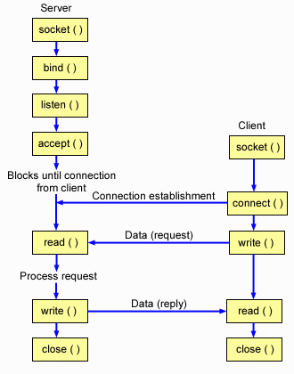
A TCP Server – Client Interaction

Slide 18
Creating a Socket
int socket(int family,int type,int protocol);
family specifies the protocol family (AF_INET for TCP/IP).
AF_INET (IPV4)
AF_INET6 (IPV6)
AF_UNIX (address family are names of Unix domain sockets)
AF_IPX (address family are IPX addresses) and so on.
For the extensive list of AF: https://man7.org/linux/man-pages/man7/address_families.7.html
type specifies the type of service (SOCK_STREAM, SOCK_DGRAM).
protocol specifies the specific protocol (usually 0, which means the default).

Slide 19
Some socket types
/*Standard socket types */
#define SOCK_STREAM 1 /*virtual circuit*/
#define SOCK_DGRAM 2 /*datagram*/
#define SOCK_RAW 3 /*raw socket*/
#define SOCK_RDM 4 /*reliably-delivered message*/
#define SOCK_CONN_DGRAM 5 /*connection datagram*/

Slide 20
socket()
The socket() system call returns a socket descriptor (small integer) or a -1 on error.
socket() allocates resources needed for a communication endpoint - but it does not deal with endpoint addressing.

Slide 21
Assigning an address to a socket
The bind() system call is used to assign an address to an existing socket.
Address of the Server
int bind( int sockfd,(struct sockaddr *)myaddr, int addrlen);
bind returns 0 if successful or -1 on error.

Slide 22
Assigning an address to a socket (cont.)
sockfd: file descriptor returned by the socket call.
myaddr: pointer to struct sockaddr that contains information about port and IP addres
struct sockaddr
{
unsigned short sa_family; // address family,AF_xxx
char sa_data[14]; // 14 bytes of protocol address
};
addrlen: length of myaddr

Slide 23
Assigning an address to a socket (cont.)
Instead of sockaddr another structure is used i.e sockaddr_in
struct sockaddr_in
{
short int sin_family; // Address family
unsigned short int sin_port; // Port number
struct in_addr sin_addr; // Internet address
unsigned char sin_zero[8]; // Same size as struct sockaddr
}
All Values should be in Network byte order
Both structures could be casted in one another.
Struct in_addr
struct in_addr
{
unsigned long s_addr; // that’s a 32-bit long, or 4 bytes
};

Slide 24
bind()
Address of the server is specified through pre defined Structure
calling bind() assigns the address specified by the sockaddr structure to the socket descriptor.

Slide 25
bind() Example
int sockfd;
struct sockaddr_in my_addr;
sockfd = socket(AF_INET, SOCK_STREAM, 0);
my_addr.sin_family = AF_INET;
my_addr.sin_port = htons(MYPORT); // short, network byte order
my_addr.sin_addr.s_addr = "10.12.110.57";
memset(&(my_addr.sin_zero), ’\0’, 8); // zero the rest of the struct
bind(sockfd, (struct sockaddr *)&my_addr, sizeof(struct sockaddr));

Slide 26
Uses for bind()
There are a number of uses for bind():
Server would like to bind to a well known address (port number).
Client can bind to a specific port.
Client can ask the O.S. to assign any available port number.

Slide 27
Port and IP address
Process of getting port and IP address can be automated
my_addr.sin_port = 0; // choose an unused port at random
my_addr.sin_addr.s_addr = INADDR_ANY; // use my IP address

Slide 28
Connection setup: listen()
int status = listen(int sock, int queuelen);
Called by passive participant
status: 0 if listening, -1 if error
sock: integer, socket descriptor
queuelen: integer, # of active participants that can “wait” for a connection
listen is non-blocking: returns immediately

Slide 29
Connect() call
int status = connect(int sock, struct *sockaddr serv_addr, int addrlen);
status: 0 if successful connect, -1 otherwise
sock: socket to be used in connection
Serv_addr: address of passive participant
addrlen: sizeof(struct sockaddr)
connect is blocking

Slide 30
Accept()
int newsockfd = accept(int sockfd, void *addr, int *addrlen);
newsockfd: the new socket (used for data-transfer)
sockfd: the orig. socket (being listened on)
addr: pointer to a local struct sockaddr_in. contains the information about the incomming connection
addrlen: should be set to sizeof(struct sockaddr_in)
adjusted by OS upon return
must be set appropriately before call
accept is blocking: waits for connection before returning

Slide 31
Sending / Receiving Data
int count = send(sock, &buf, len, flags);
count: # bytes transmitted (-1 if error)
buf: char[], buffer to be transmitted
len: integer, length of buffer (in bytes) to transmit
flags: integer, special options, usually just 0
int count = recv(sock, &buf, len, flags);
count: # bytes received (-1 if error)
buf: void[], stores received bytes
len: # bytes received
flags: integer, special options, usually just 0
Calls are blocking [returns only after data is sent (to socket buf) / received]
Can use read/write as well!

Slide 32
Close()
When finished using a socket, the socket should be closed:
Int status = close(s);
status: 0 if successful, -1 if error
s: the file descriptor (socket being closed)
Closing a socket
closes a connection (for SOCK_STREAM)
frees up the port used by the socket

Slide 33
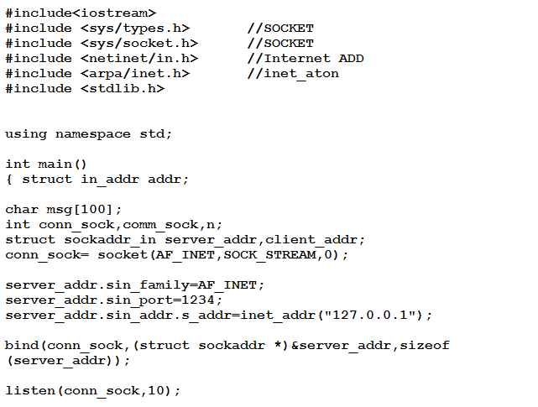
Example: A TCP Server

Slide 34
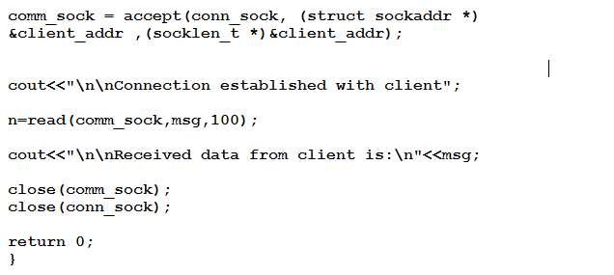
Example: A TCP Server

Slide 35
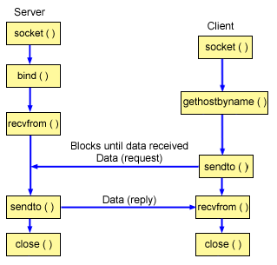
A UDP Server – Client Interaction

Slide 36
Iterative servers
Server is iteratively waiting for clients.
Iterative servers are simple and are suitable for transactions that do not last long.
When a client calls connect function, server connected with it and gives it services.
An iterative server iterates through each client, handling it one at a time.
During this period no more client can connect with the server because it is tie up with a single client.

Slide 37
A TCP Server – Client Interaction

Slide 38
A UDP Server – Client Interaction

Slide 39




UDP Client Server
UDP is a connectionless, unreliable, datagram protocol, quite unlike the connection-oriented, reliable byte stream provided by TCP.
In a typical UDP client/server model. The client does not establish a connection with the server. Instead, the client just sends a datagram to the server using the sendto() function, which requires the address of the destination (the server) as a parameter.
Similarly, the server does not accept a connection from a client. Instead, the server just calls the recvfrom() function, which waits until data arrives from some client.
recvfrom() returns the protocol address of the client, along with the datagram, so the server can send a response to the correct client.
Notes:
you can actually use connect() on UDP socket as an option. In that case, you can use send()/recv() on the UDP socket to send data to the address specified with the connect() and to receive data only from the address. (The connect() on UDP socket merely sets the default peer address and you can call connect() on UDP socket as many times as you want, and the connect() on UDP socket, of course, does not perform any handshake for connection.)

Slide 40





Sendto()/recvfrom() functions
ssize_t sendto(int sockfd, const void *buff, size_t nbytes, int flags, const struct sockaddr *to, socklen_t addrlen);
ssize_t recvfrom(int sockfd, void *buff, size_t nbytes, int flags, struct sockaddr *from, socklen_t *addrlen); sizeof(from)
The first three arguments, sockfd, buff, and nbytes, are identical to the first three arguments for read and write.
The to argument for sendto() is a socket address structure containing the protocol address (e.g., IP address and port number) of where the data is to be sent.
The size of this socket address structure is specified by addrlen
Notes:
f int flags are equal to 0, it means that no flags are specified. these are optional. to answer about ORing flags - it is a mechanism that allow you to specify more than one flag - MSG_CONFIRM | MSG_DONTWAIT specify two flags.

Slide 41



Sendto()/recvfrom() functions
The recvfrom() function fills in the socket address structure pointed to by from with the protocol address of who sent the datagram.
The number of bytes stored in this socket address structure is also returned to the caller in the integer pointed to by addrlen
Both functions return the length of the data that was read or written as the value of the function
Notes:
f int flags are equal to 0, it means that no flags are specified. these are optional. to answer about ORing flags - it is a mechanism that allow you to specify more than one flag - MSG_CONFIRM | MSG_DONTWAIT specify two flags.

Slide 42

Why we need sendto()/recvfrom()
Usually, sendto() and recvfrom() are used for datagram sockets, and send() and recv() are used for stream sockets
If the socket is not in a connected state, additional address information must be passed to sendto() and can be (optionally) returned from recvfrom()
bytes_sent=sendto(s, data_sent, sizeof(data_sent), 0, (struct sockaddr*)&to, sizeof(to));
addrlen = sizeof(from); /* must be initialized */
bytes_received = recvfrom(s, data_received, sizeof(data_received), 0, &from, &addrlen)

Slide 43
Get arguments from CLI Mode
int main(char *argv[], int argc )
File= argv[0]; // ./client
Port=argv[1]l;//8080
Ip=argv[2];// 127.0.0.1
If (argc<3)
Cout<<“provide complete arguments”;
else
Cout<<“Success”;

